Slide 1

COVID-19 Vaccine Comms Pack
Voluntary, Community and Social Enterprise organisations

Slide 2

What’s included?
This comms pack has been produced to support you in sharing and disseminating information about COVID-19 vaccines through your networks. The pack includes;
Guidance and basic explanations you can use answering ‘What is a vaccine?’
Comms assets and resources on vaccines you can use and share
Vaccine resources for British Sign Language users
Key messages on COVID-19 Vaccine Scams
Misinformation - assets and copy you can use to tackle misinformation on vaccines

Slide 3

What are Vaccines?
Vaccines reduce the spread of infectious diseases and even get rid of some altogether. Vaccination is the most important thing you can do to protect your community against serious illnesses
When enough people get vaccinated, it’s harder for a disease to spread to those who can’t have vaccines.
Vaccines are designed to prevent people from getting serious infectious diseases. It is much safer for your immune system to learn how to fight illnesses through vaccination than by catching and treating them.
Vaccines go through several stages of lab tests and clinical trials before they can be approved for use. Regulators review the results of these trials to check whether a vaccine meets the required levels of safety and effectiveness.
After any vaccine is licensed for use in the UK, it is monitored by the @MHRAgovuk. This is an important part of making sure vaccines continue to meet safety standards on an ongoing basis.
You can access the Government’s Vaccine Delivery Plan here.

Slide 4

Vaccine Comms Products and Resources
This folder gives you access to a google drive folder which contains a number of social media assets which you can share through your networks. The Department for Health and Social Care will continue to update this folder with assets, including;
  Short video clips and images
  Vaccine fact cards
  Adult Social Care COVID-19 vaccine Q&A
Public Health England campaign resource centre includes, social media animations, explainer videos, email signatures.

Slide 5

Example
Dr Amir Khan answering ‘Do vaccines contain pork products?

Slide 6
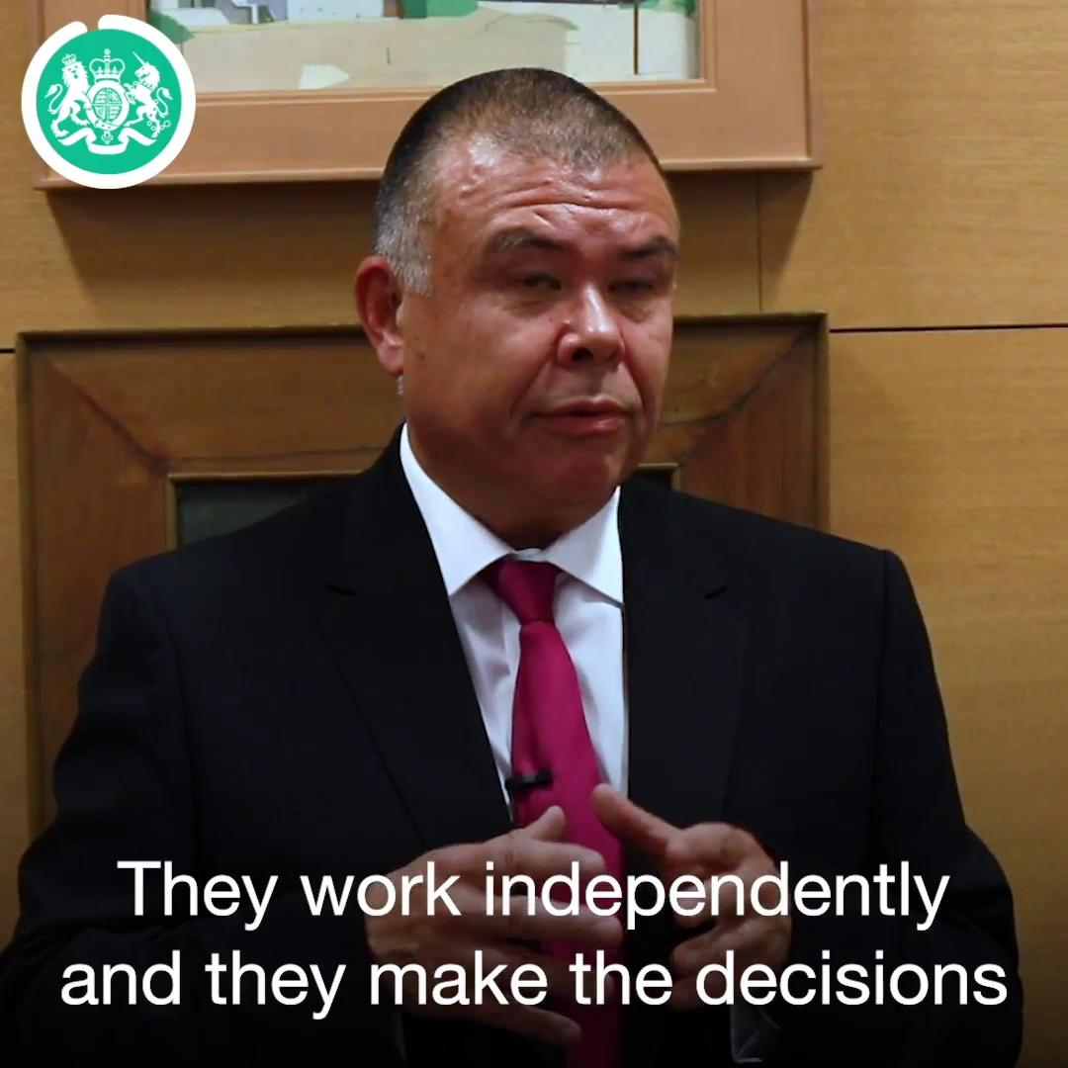
Example
Professor Jonathan Van-Tam: How are Covid Vaccines being developed?

Slide 7
Languages: Translated COVID-19 Guidance
This link contains to guidance on Covid-19 translated in to many different languages.
COVID-19 resources in your language: guidance and advice in various languages on topics such as health and wellbeing, employment and welfare, domestic abuse, housing and homelessness
Doctors of the World have provided translated resources into 60 languages aimed at migrants and asylum seekers which are informed by government and NHS advice.

Slide 8
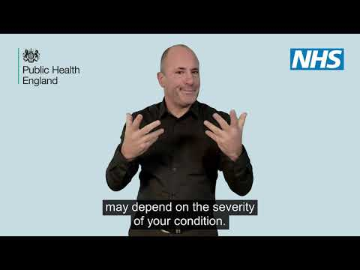
British Sign Language
SignHealth and BTM Projects have produced coronavirus information videos in British Sign Language.
NHS Leicester City have produced a series of videos about coronavirus in British Sign Language
Example clip: COVID-19 vaccination: guide for older adults in BSL, (NHS, Public Health England)

Slide 9

Tackling Misinformation
You can help to tackle vaccine misinformation within communities. Encourage people to use the SHARE checklist.
Below is some sample mis and disinformation newsletter copy:
‘Before you like, comment or share content online, use the SHARE checklist to make sure you’re not contributing to the spread of harmful content.’
‘False information, when shared, can take on a life of its own and have serious consequences. Recently there has been a lot of false information about coronavirus and the new vaccines designed to tackle it. It’s not always easy to spot. The SHARE checklist is an easy tool to pass on to people in your community to help them know what to look out for before they like, comment or share information they come across online.’

Slide 10
Tackling Misinformation
Below is some sample mis and disinformation copy which you can use on social media:
Sharing false information about coronavirus vaccines can be dangerous. Make sure you’re not contributing to the spread of harmful content — read the SHARE checklist: https://sharechecklist.gov.uk/. #Misinformation #COVID19 #COVIDVaccine #SafeOnline
False information about coronavirus and vaccines are regularly shared online. The SHARE checklist can help you spot this harmful content, and protect yourself and others: https://sharechecklist.gov.uk/. #Misinformation #COVID19 #COVIDVaccine #SafeOnline
The SHARE checklist is there to help you spot false or misleading online information. Read it to minimise the spread of harmful content: https://sharechecklist.gov.uk/ #Misinformation #SafeOnline #COVID19 #COVIDVaccine
False information online can be difficult to spot. By using the SHARE checklist, you can help minimise the spread of harmful content: https://sharechecklist.gov.uk/ #Misinformation #COVID19 #COVIDVaccine #SafeOnline

Slide 11
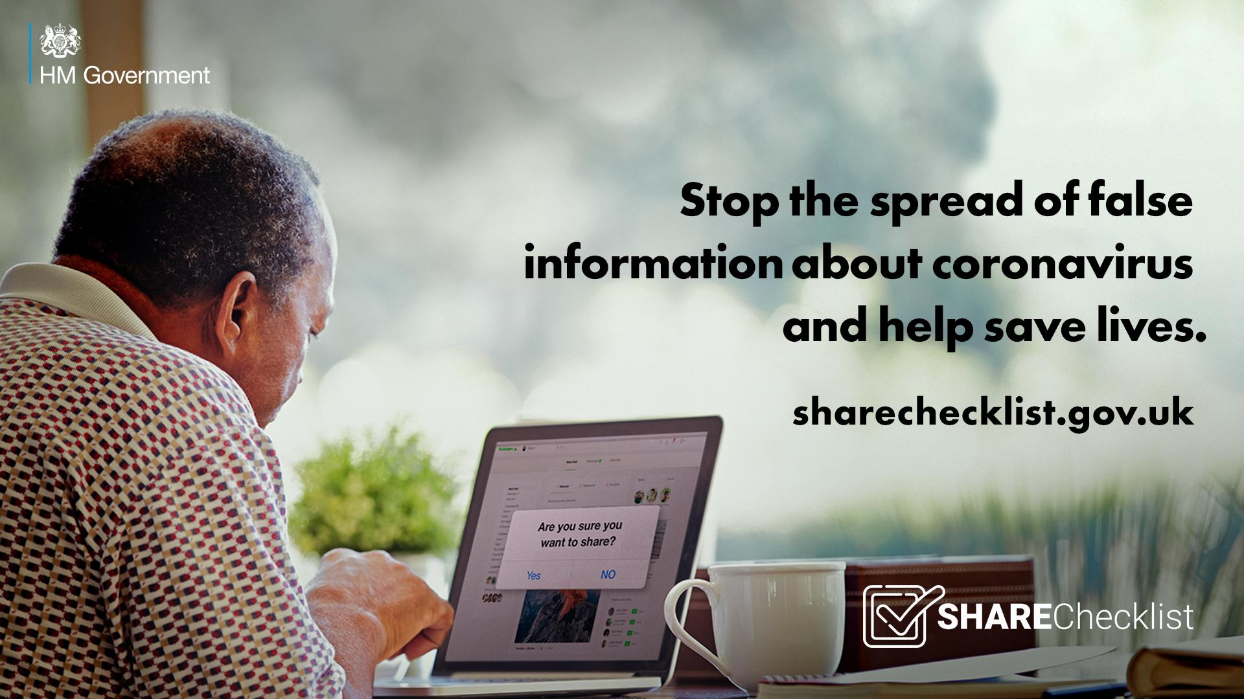
Example: Tackling Misinformation

Slide 12
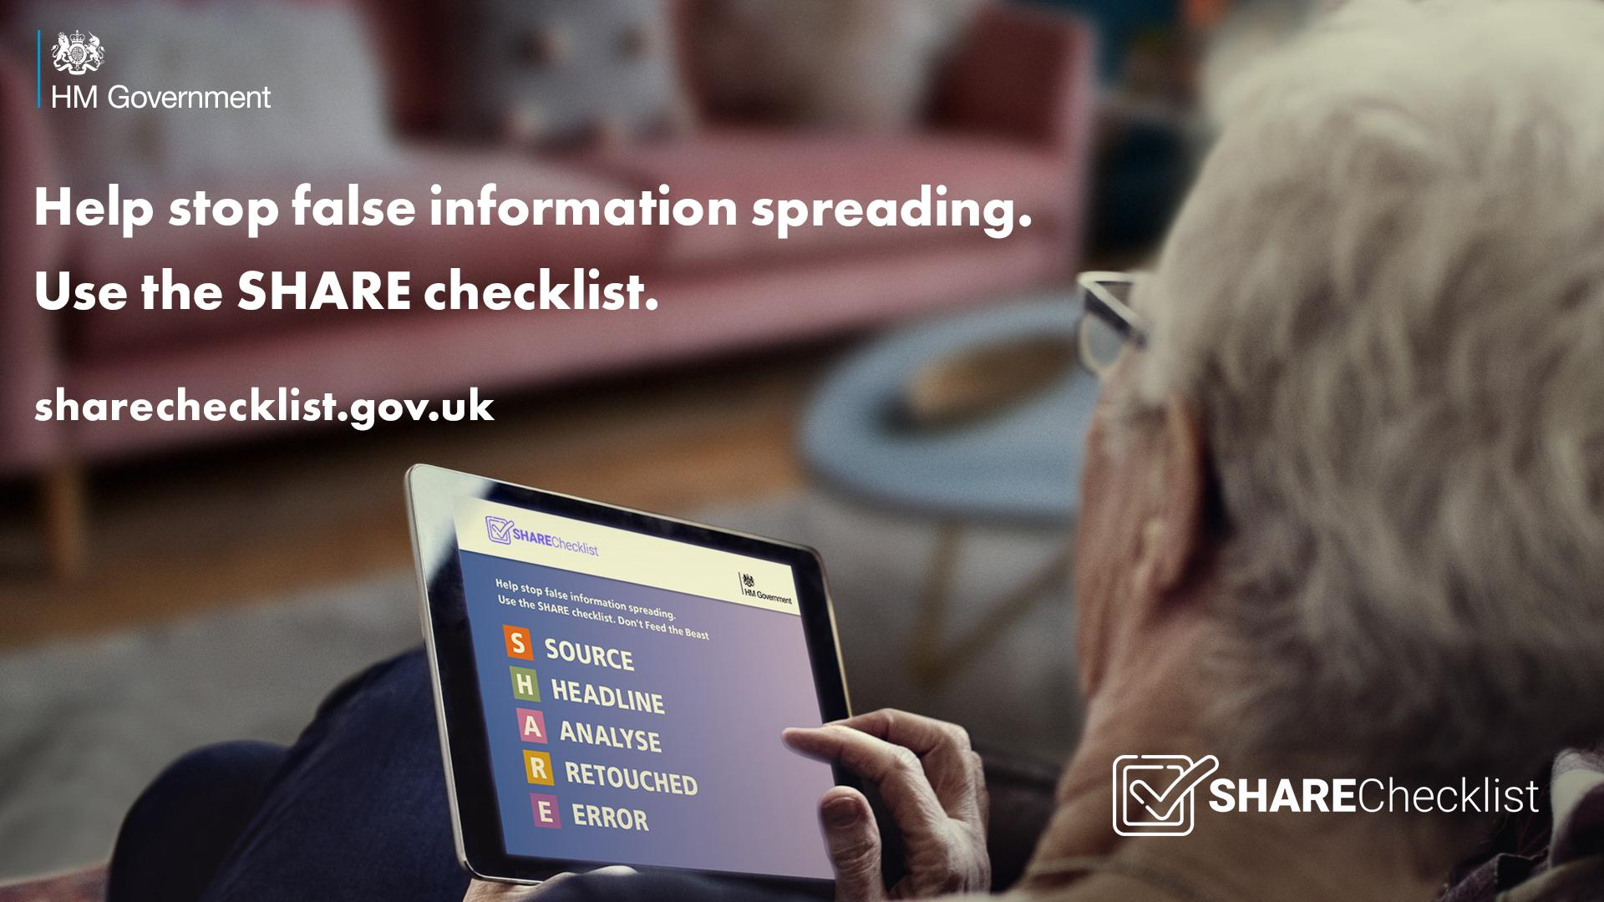
Example: Tackling Misinformation

Slide 13
Tackling Misinformation: Next steps
DCMS is working with the National Resilience Hub at the Cabinet Office and the Ministry for Housing, Communities and Local Government and their Community Champions scheme to develop a social media toolkit targeted at groups particularly vulnerable to mis and disinformation about the vaccine (BAME, Jewish Orthodox, Gypsy and Traveller communities).
These assets will be pushed out by trusted community leaders and health professionals representing these groups on channels commonly used to spread false information including WhatsApp, private Facebook groups and forums as well as Twitter, Facebook and Instagram.
This will be ready to share in the coming weeks.

Slide 14
Key messages on COVID-19 Vaccine Scams
Remember, the vaccine is only available on the NHS and is free of charge. The NHS will never ask you for details about your bank account or to pay for the vaccine. If you receive an email, text message or phone call purporting to be from the NHS and you are asked to provide financial details, this is a scam.
  The NHS will never ask you for your bank account or card details.
  The NHS will never ask you for your PIN or banking password.
  The NHS will never arrive unannounced at your home to administer the vaccine.
  The NHS will never ask you to prove your identity by sending copies of personal documents such as your passport, driving licence, bills or pay slips.
If you believe you are the victim of a fraud, please report this to Action Fraud as soon as possible by calling 0300 123 2040 or visiting www.actionfraud.police.uk

Slide 15
How can you help?
Disseminate these key messages through social media, newsletters and through your networks
Consider hosting vaccine Q&A sessions with your networks - contact Tarum Bans tarum.bans@dcms.gov.uk to enquire about arranging a speaker
Feedback any questions, issues or concerns you are hearing to Tarum Bans tarum.bans@dcms.gov.uk

